Slide 2
Photon Relaxation
Ben Spencer

Slide 3
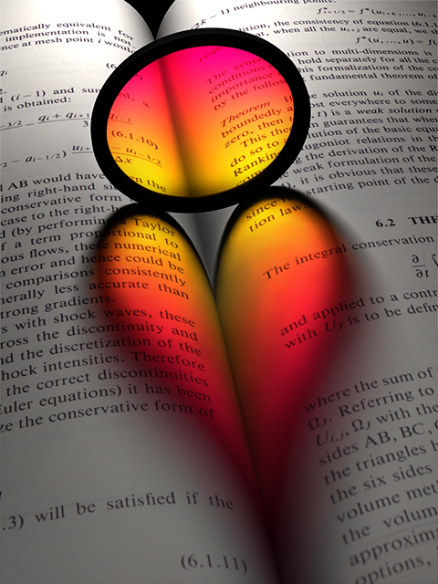
Introduction
Photon relaxation is a contribution to the area of error minimization in photon density estimation:
Estimate error is the sum of bias and noise.
Goal is to reduce noise without increasing apparent bias.
Problem often addressed at the kernel level with filters/intelligent bandwidth selection.
Photon relaxation is different in that it directly manipulates the underlying point dataset.

Slide 4
Background
Challenges facing kernel-based noise removal:
Tricky to preserve high-frequency detail – particularly at sub-kernel scales – while ensuring adequate smoothing; noise removal and bias are correlated.
Wide bandwidths required to effectively filter all-frequency noise - increases rendering cost.
Photon relaxation addresses both of these points. Salient features of caustics can be preserved on a fine scale while allowing noise removal on a broader scale due to diffusion.
Furthermore, the relaxed distribution allows the use of very low-bandwidth kernels.

Slide 5
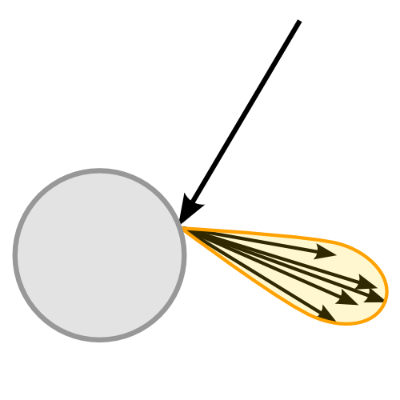
Background
What causes noise?
Two factors:
Point discrepancy. Caused by stochastic processes (e.g. scattering) and photon decoherence (geometry) during the particle tracing step.

Slide 6
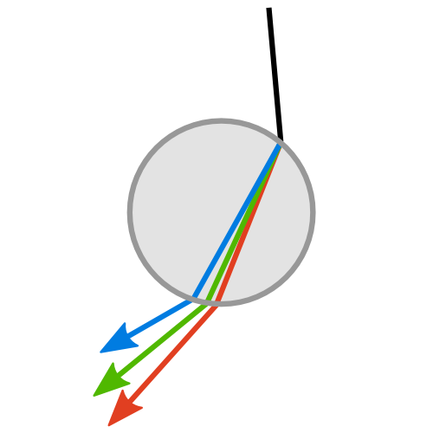
Background
What causes noise?
Two factors:
Point discrepancy. Caused by stochastic processes (e.g. scattering) and photon decoherence (geometry) during the particle tracing step.
Variance in photon flux. This can be caused by absorption, attenuation, dispersion through dielectric media, etc.

Slide 7
Photon Relaxation
Basic principles:
Use point repulsion to minimize local discrepancy.

Slide 8
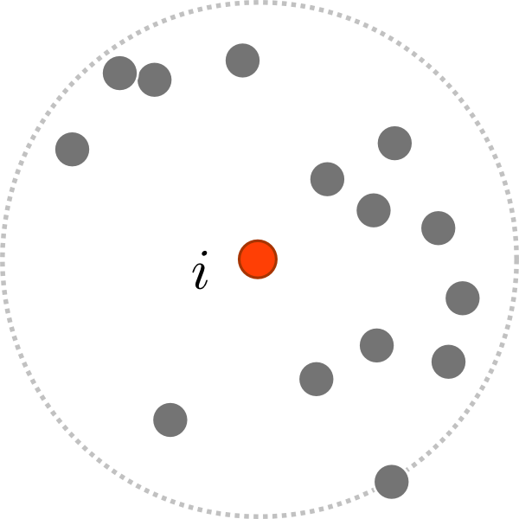
Photon Relaxation
1. For each photon, i, gather K-nearest neighbours to i.

Slide 9
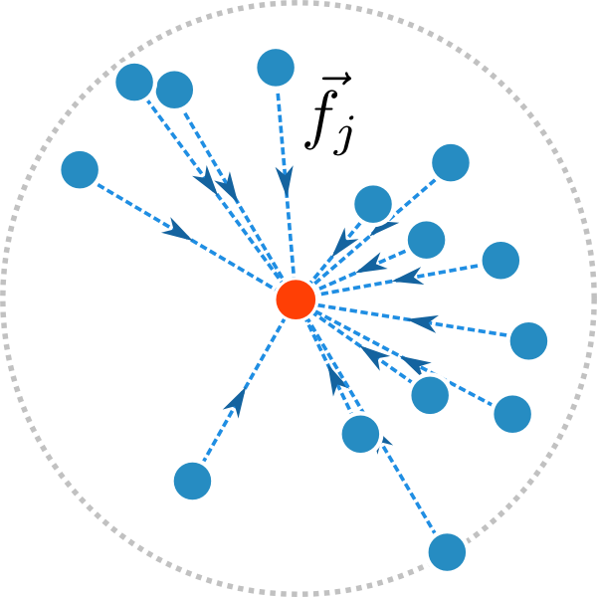
Photon Relaxation
1. For each photon, i, gather K-nearest neighbours to i.
2. Compute individual repulsive forces on i from members, j, of K.

Slide 10
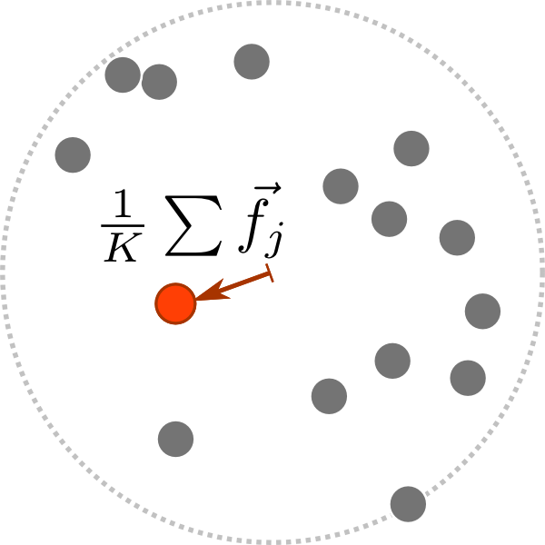
Photon Relaxation
1. For each photon, i, gather K-nearest neighbours to i.
2. Compute individual repulsive forces on i from members, j, of K.
3. Apply mean of forces to position of i.

Slide 11
Photon Relaxation
Basic principles:
Use point repulsion to minimize local discrepancy.

Slide 12
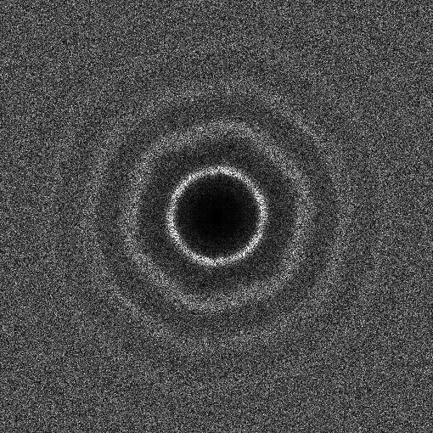
Photon Relaxation
Basic principles:
Use point repulsion to minimize local discrepancy.
Aim to relax distribution so it exhibits a blue noise spectral signature and low angular anisotropy.

Slide 13
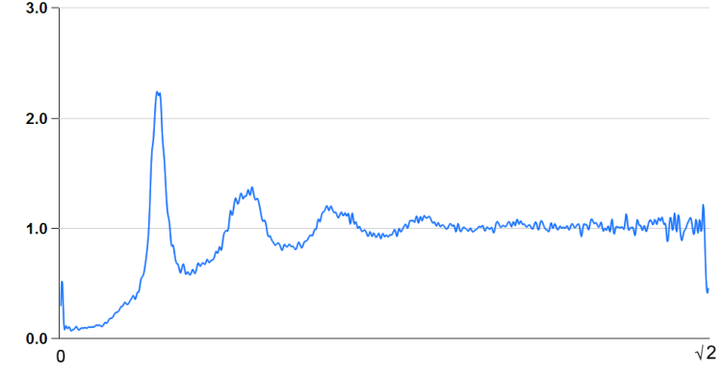
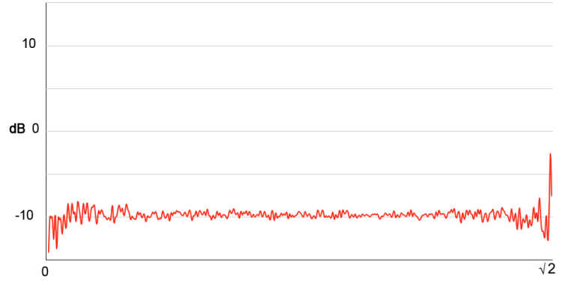
Photon Relaxation
Basic principles:
Use point repulsion to minimize local discrepancy.
Radially-averaged power spectrum
Aim to relax distribution so it exhibits a blue noise spectral signature and low angular anisotropy.
Angular anisotropy

Slide 14
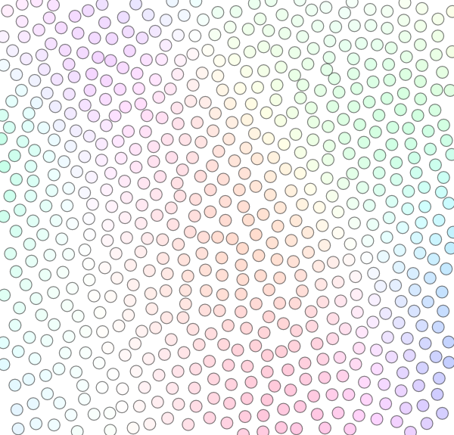
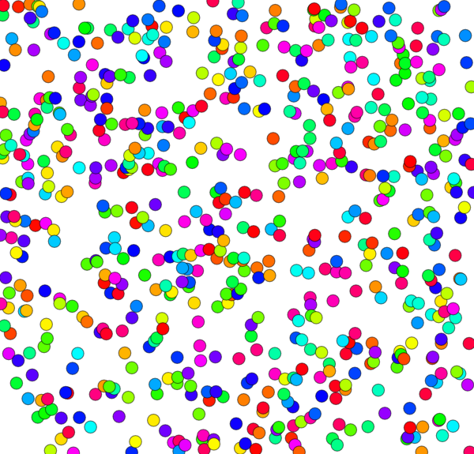
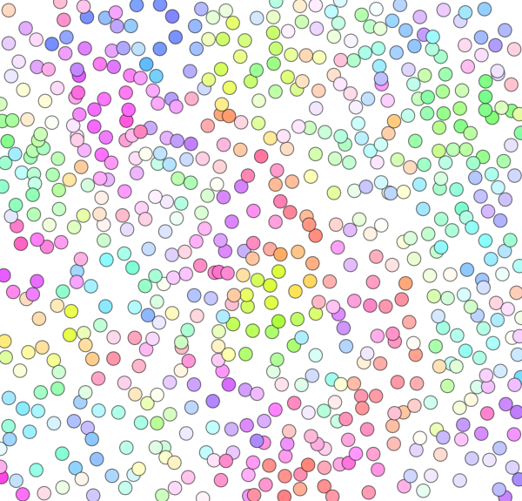
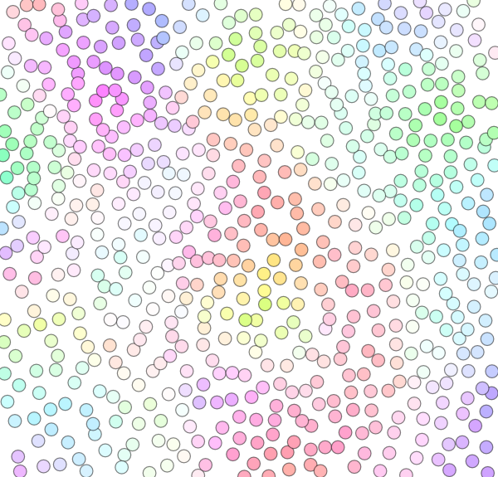
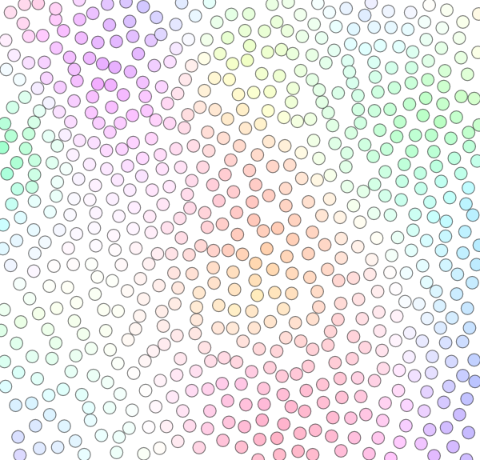
Photon Relaxation
Basic principles:
Use point repulsion to minimize local discrepancy.
Aim to relax distribution so it exhibits a blue noise spectral signature and low angular anisotropy.
Use diffusion to homogenize flux between photons.

Slide 15
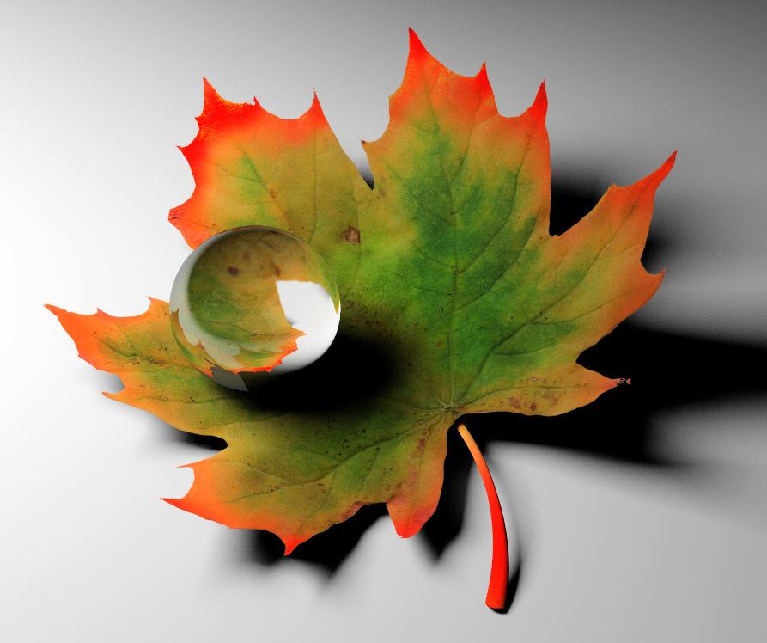
Photon Relaxation

Slide 16
Photon Relaxation
Noise!

Slide 17
Photon Relaxation

Slide 18
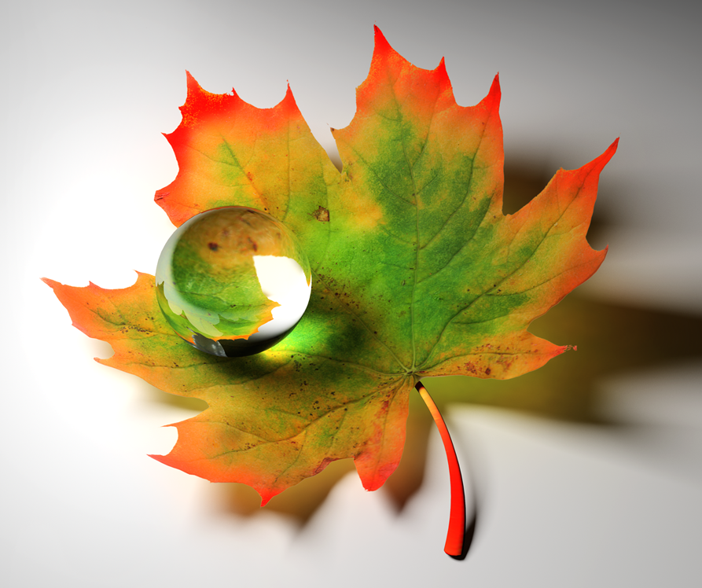
Photon Relaxation

Slide 19
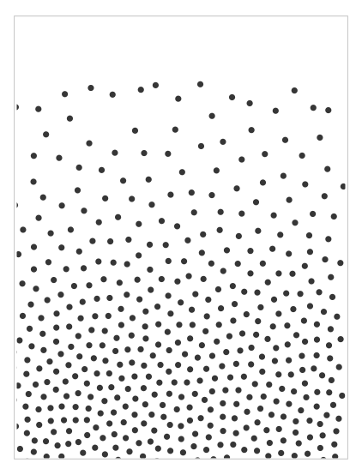
Feature Detection and Preservation
Relaxation removes noise effectively, but photon diffusion also degrades larger-scale features of the distribution.
Sample PDF
Stochastically-seeded photon distribution
Diffusion results in degraded reconstruction

Slide 20
Feature Detection and Preservation

Slide 21
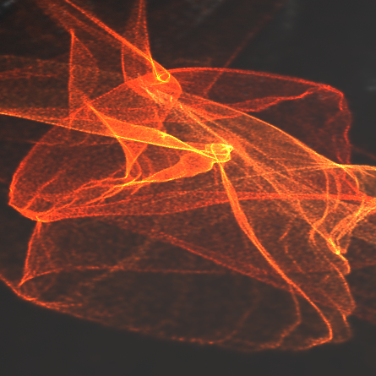
Feature Detection and Preservation
?
Before relaxation
After relaxation. High-frequency detail has been lost due to diffusion.
Can we do better?

Slide 22
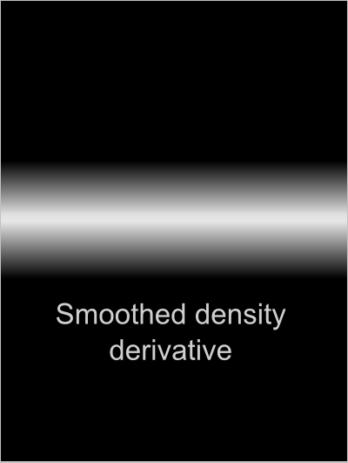
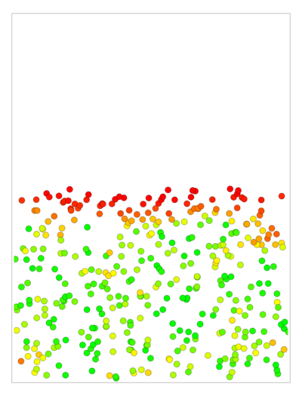
Feature Detection and Preservation
Feature detection aims to preserve these features by detecting and inhibiting motion in the direction of migration.
Sample PDF
Photons migrate along direction of density derivative.
Feature detection constrains photons in the direction of migration (red = constrained).
Reconstructed distribution better preserves PDF.

Slide 23
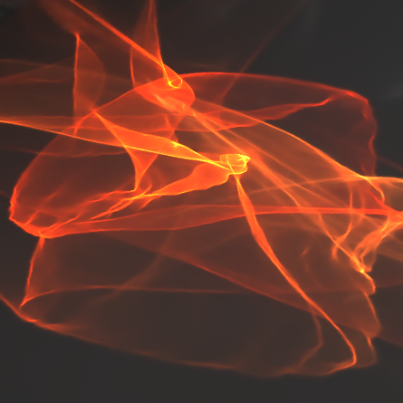
Feature Detection and Preservation
Before relaxation
Relaxation with no constraints
Relaxation with constraints

Slide 24
Thank you!

Slide 25
This slide has a 16:9 media window

